Slide 1
Cornerstone City Church Peninsula Plus Community Hoo Are Ya
6th April 2025

Slide 2


Slide 3
Great Big God
CCLI Song # 3373437
Jo Hemming | Nigel Hemming
© 2001 Vineyard Songs (UK/Eire) (Admin. by Integrity Music Ltd)
For use solely with the SongSelect® Terms of Use. All rights reserved. www.ccli.com
CCLI Licence No. 33265

Slide 4
1/2
Our God is a great big God
Our God is a great big God
Our God is a great big God
And He holds us in His hands

Slide 5
2/2
He's higher than a skyscraper
And He's deeper than a submarine
He's wider than the universe
And beyond my wildest dreams
And He's known me and He's loved me
Since before the world began
How wonderful to be a part of
God's amazing plan

Slide 6
Thanksgiving
CCLI Song # 7199589
Nick Herbert | Taku Mudere | Zo Chilengwe
© Capitol CMG Genesis; Safe and Sound Music; Remaining portion is unaffiliated
For use solely with the SongSelect® Terms of Use. All rights reserved. www.ccli.com
CCLI Licence No. 33265

Slide 7
1/8
Enter in (Enter in)
His courts with praise (His courts with praise)
For He is greatly (He is greatly)
To be praised (To be praised)

Slide 8
2/8
What shall we do
We shall lift up a shout
What shall we do
We shall praise Him
What shall we do
For our God made a way
We'll give Him our thanksgiving

Slide 9
3/8
Magnify (Magnify)
His Holy Name (His Holy Name)
For He is greatly (For He is greatly)
To be praised (To be praised)

Slide 10
4/8
What shall we do
We shall lift up a shout
What shall we do
We shall praise Him
What shall we do
For our God made a way
We'll give Him our thanksgiving

Slide 11
5/8
Even if the rocks cry out
We're gonna drown them out
With a louder shout of praise
Even when the battles roar
We're gonna praise You Lord
'Cause You are always worthy

Slide 12
6/8
You are worthy
Worthy of honour and praise
You are worthy
We'll sing it again and again

Slide 13
7/8
What shall we do
We shall lift up a shout
What shall we do
We shall praise Him
What shall we do
For our God made a way
We'll give Him our thanksgiving

Slide 14
8/8
We'll give Him our thanksgiving
We'll give Him our thanksgiving

Slide 16
Mighty Name Of Jesus
CCLI Song # 7244496
Hope Darst | Jacob Sooter | Lauren Sloat
© 2024 Fair Trade Global Songs; Hope For The Best Songs; TBCO Publishing; Just When Publishing; So Essential Tunes; Remaining portion is unaffiliated
For use solely with the SongSelect® Terms of Use. All rights reserved. www.ccli.com
CCLI Licence No. 33265

Slide 17
1/6
I pray into the atmosphere
Spirit of God You're here
You have all authority
I pray over my heart and mind
I am healed by Your stripes
Your blood declares that I am free

Slide 18
2/6
In the mighty name of Jesus I pray
Calling on the power of heaven I proclaim
Every weapon formed against me must break
In the mighty name of Jesus

Slide 19
3/6
I draw a permanent boundary line
The enemy has no rights
To come near my family
No scheme could ever undo God's plans
No matter the circumstance
The cross has sealed my destiny

Slide 20
4/6
In the mighty name of Jesus, I pray
Calling on the power of heaven I proclaim
Every weapon formed against me must break
In the mighty name of Jesus In the mighty name of Jesus, I know
All the power of fear and darkness must go
'Cause every key to every victory I hold
In the mighty name of Jesus

Slide 21
5/6
I will not fear I will not fear
When the enemy comes near
On the doorframe of my life
Is the blood of Jesus Christ
I will not fear I will not fear
There's an army of angels here
I'm protected on all sides
By the blood of Jesus Christ

Slide 22
6/6
In the mighty name of Jesus, I pray
Calling on the power of heaven I proclaim
Every weapon formed against me must break
In the mighty name of Jesus In the mighty name of Jesus, I know
All the power of fear and darkness must go
'Cause every key to every victory I hold
In the mighty name of Jesus

Slide 24
Shout To The Lord
CCLI Song # 1406918
Darlene Zschech
© 1993 Wondrous Worship (Admin. by Song Solutions www.songsolutions.org)
For use solely with the SongSelect® Terms of Use. All rights reserved. www.ccli.com
CCLI Licence No. 33265

Slide 25
1/3
My Jesus my Saviour
Lord there is none like You
All of my days I want to praise
The wonders of Your mighty love
My comfort my shelter
Tower of refuge and strength
Let every breath all that I am
Never cease to worship You

Slide 26
2/3
Shout to the Lord
All the earth let us sing
Power and majesty
Praise to the King
Mountains bow down
And the seas will roar
At the sound of Your name

Slide 27
3/3
I sing for joy
At the work of Your hands
Forever I'll love You
Forever I'll stand
Nothing compares to the promise
I have in You

Slide 28
1/1
This is our God this is who He is
He loves us
This is our God this is what He does
He saves us
He bore the cross beat the grave
Let heaven and earth proclaim
This is our God King Jesus

Slide 30


Slide 31
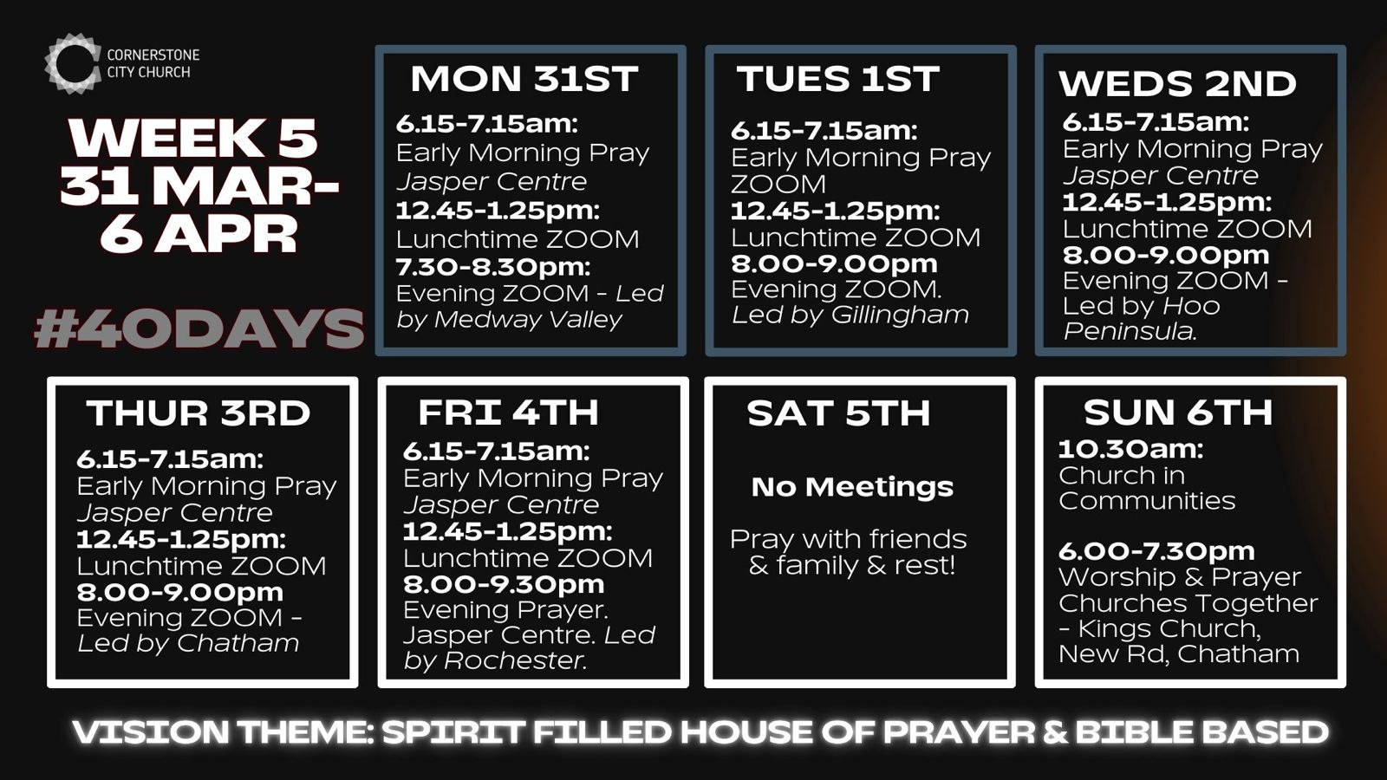

Slide 32


Slide 33


Slide 35
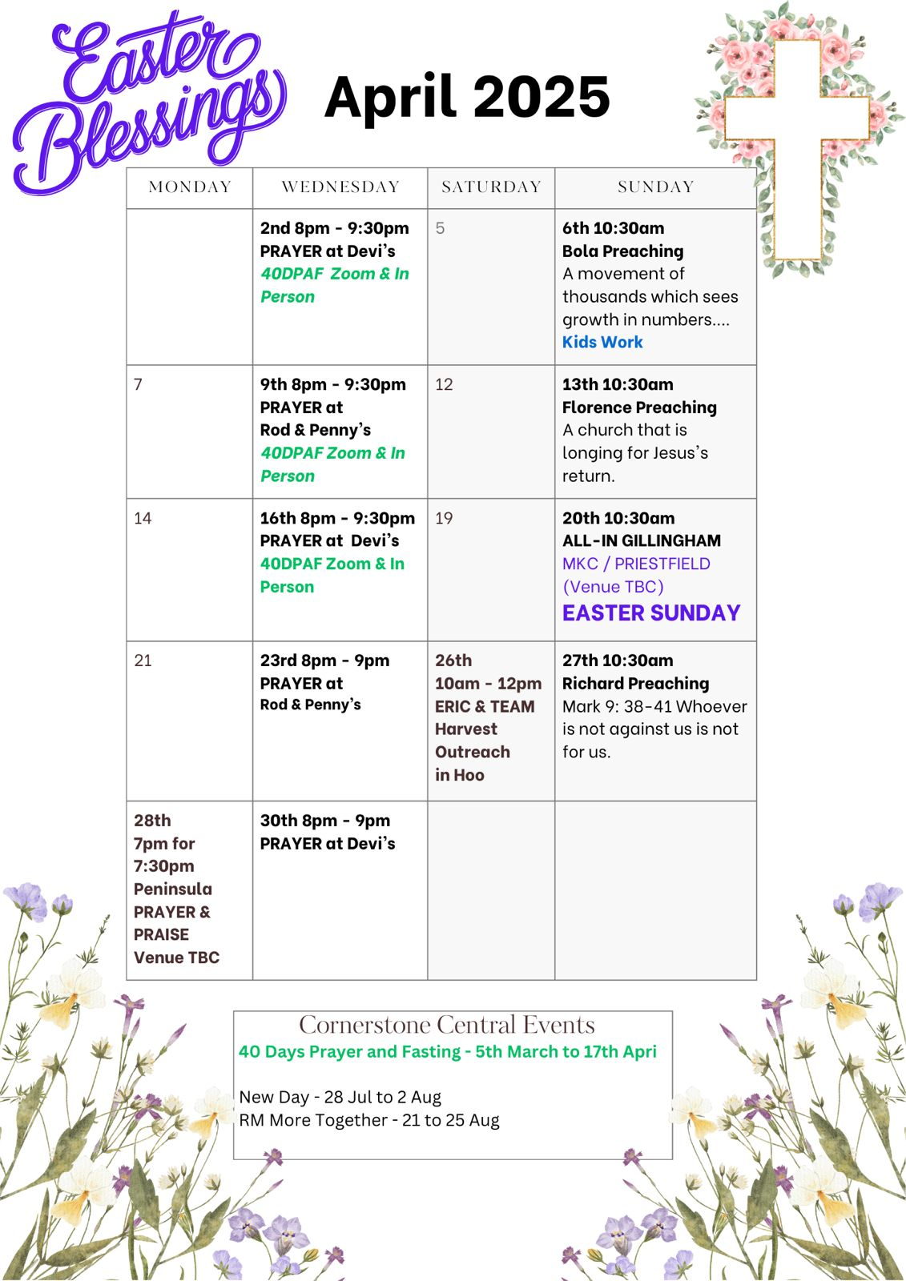

Slide 36

Grow Group 1
Grow Group 1 Name: On YOUR MARK!

Slide 37
Leaders
Leaderss
Phil & Kim
Maria (Mia) Warren
Matthew Harrison
Richard & Elisha Acheampong
Phil & Kim
Maria (Mia) Warren
Matthew Harrison
Richard & Elisa Acheampong

Slide 38
Q1 into Q2 Meeting Dates
Q1 into Q2 Meeting Dates
Month | Date / Day | Host
January | Saturday 11th | Maria
 | Wednesday 22nd | Maria
February | Saturday 8th | Venue Needed
 | Wednesday 19th | Phil & Kim
March | Saturday 8th | Richard & Elisha
 | Wednesday 19th | Venue Needed
April | Saturday 12th | Matt
 | Wednesday 30th | Venue Needed

Slide 39

Storm Walker
Storm Walker
Symbolising, trust in Jesus Christ through life's storms.
Mark 4:35-41

Slide 40


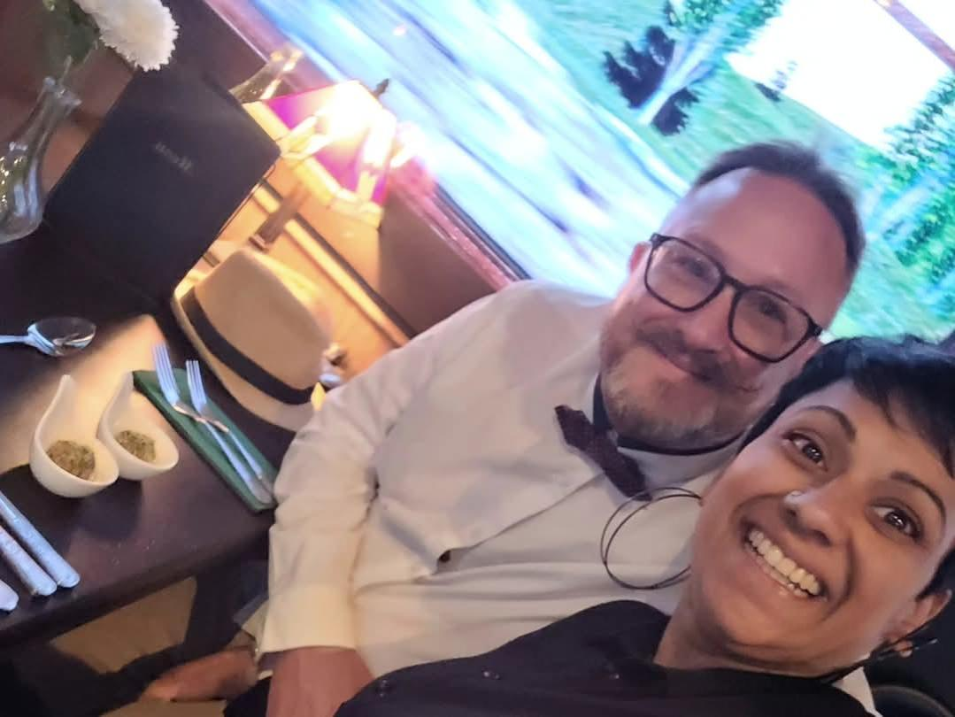
Group Leaders
Micheal and Mwamba
Wilfred and Parveen
Hannah

Slide 41
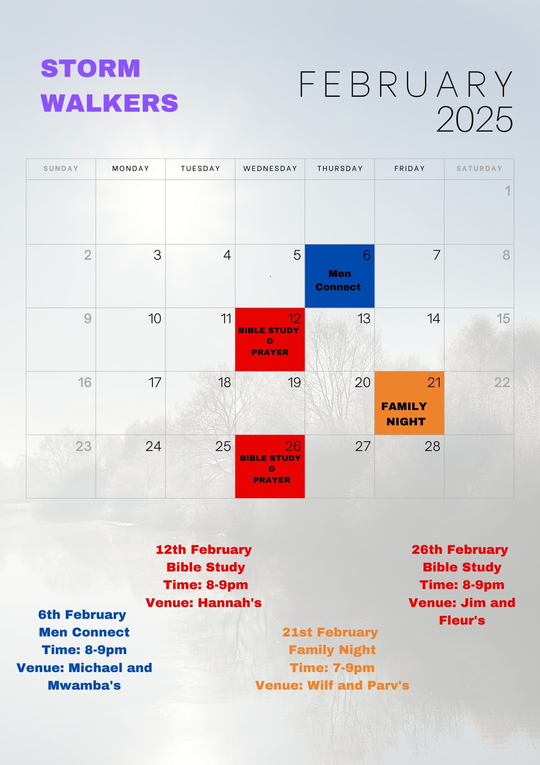

Slide 42


Slide 43
2 Corinthians 14 May the grace of the Lord Jesus Christ, and the love of God, and the fellowship of the Holy Spirit be with you all
Surely goodness and mercy shall follow me all the days of my life, and I shall dwell in the house of the Lord forever.

